Slide 1





C# Databases Advanced with Microsoft SQL Server
Course Overview
C# DB
Advanced
SoftUni Team
Technical Trainers
Software University
http://softuni.bg

Slide 2



Table of Contents
Course Overview
Trainers Team
Course Schedule
Exams and Evaluation
Learning Resources

Slide 3


Databases Advanced
Advanced
Course Objectives & Program

Slide 4

Course Topics
The Databases Advanced course covers
Connecting to a DB instance
Writing an ORM Framework
Entity Framework Core
Code First and DB First implementations
Programming Patterns
Working with data in other formats (XML, JSON)

Slide 5
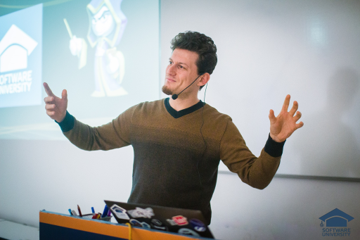
The Trainers Team

Slide 6

Trainers Team
Boris Kostov
Technical Trainer @ SoftUni
Student @ Sofia University
Information Systems
Interests in C#
Personal Trainer

Slide 7
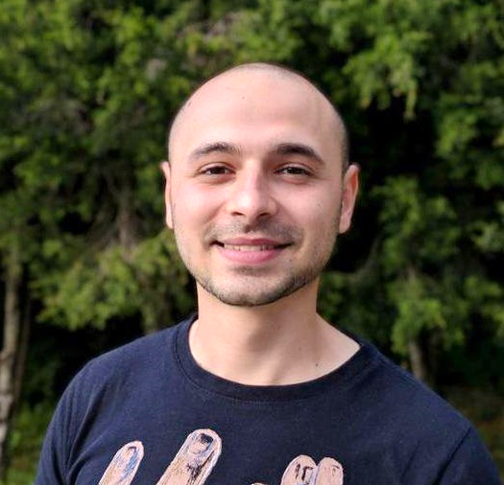
Trainers Team
Stoyan Shopov
Technical Trainer @ SoftUni
ASP.NET Web Developer
Experience with MSSQL, ADO.NET
Interested in self-development and business
Mountain lover

Slide 8
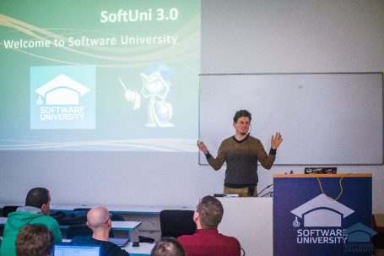


Databases Advanced
Course Details and Schedule

Slide 9
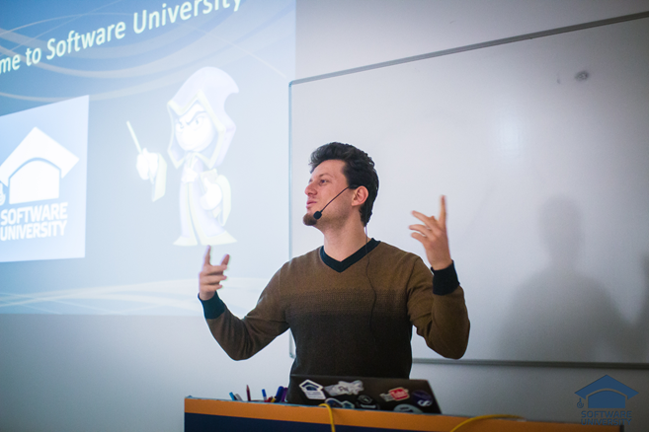
Training Duration and Schedule
Lessons: ~ 34 hours (onsite + YouTube videos)
Practical exercises (in class): ~ 60 hours
Homework: ~ 0-60 hours
Time frame
25-Jun-2018 – 12-Aug-2018

Slide 10


Why English?
Why are the slides in English?
English is the native language of the software engineers
Specific terminology should be in English
Translations are inaccurate and funny
Just learn English!
No excuses

Slide 11


Your RFID Chip
Students can either
Take RFID chip from SoftUni
Or use their own chip / card (125 KHz)
Register your chip number in your SoftUni profile: https://softuni.bg/users/profile/show
Check-in at the reception every time when you come in SoftUni
See your last visits in your profile: https://softuni.bg/users/profile/show

Slide 12


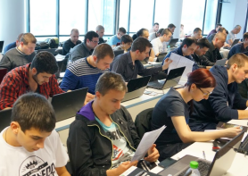
Databases Advanced
Evaluation Criteria

Slide 13


Scoring System for the Course
Mandatory:
Final exam – 90%
Exercises & homework – 10%
Bonuses:
Presence in class – 5% bonus
Forum activity – bonus up to 5%

Slide 14


Homework Assignments & Exercises
Your homework is mainly work in class!
Lesson days → slides + live demos + exercises
Exercise days → only exercises
How to submit your homework?
Submitted in the judge system
Do your homework when it's due!
Assignments pile up quickly

Slide 15










Resources
What We Need Additionally?

Slide 16



Course Web Site, Forum and FB Group
Official web site:
Official discussion forum:
Official Facebook group:
https://softuni.bg/courses/databases-advanced-entity-framework
softuni.bg/forum/categories/64
facebook.com/groups/ SoftUniCsharpDBFundamentalsMay2018/

Slide 17

The Databases Advanced Slides and Videos
All lecture slides, videos, homework assignments, projects and other resources are open content, available for free
Visit the course web site to access the course resources

Slide 18



Recommended Software
Software needed for this course:
Microsoft SQL Server & Management Studio https://www.microsoft.com/en-us/sql-server/sql-server-2017
Visual Studio 2017 – https://www.visualstudio.com

Slide 19







Course Introduction
https://softuni.bg/courses/databases-advanced-entity-framework

Slide 20






SoftUni Diamond Partners

Slide 21






SoftUni Diamond Partners

Slide 22
License
This course (slides, examples, demos, videos, homework, etc.) is licensed under the "Creative Commons Attribution-NonCommercial-ShareAlike 4.0 International" license
Attribution: this work may contain portions from
"Databases" course by Telerik Academy under CC-BY-NC-SA license

Slide 23





Trainings @ Software University (SoftUni)
Software University – High-Quality Education, Profession and Job for Software Developers
softuni.bg
Software University Foundation
http://softuni.foundation/
Software University @ Facebook
facebook.com/SoftwareUniversity
Software University Forums
forum.softuni.bg

